Slide 1


DEMO day – 17 MARCH 2023

Slide 2
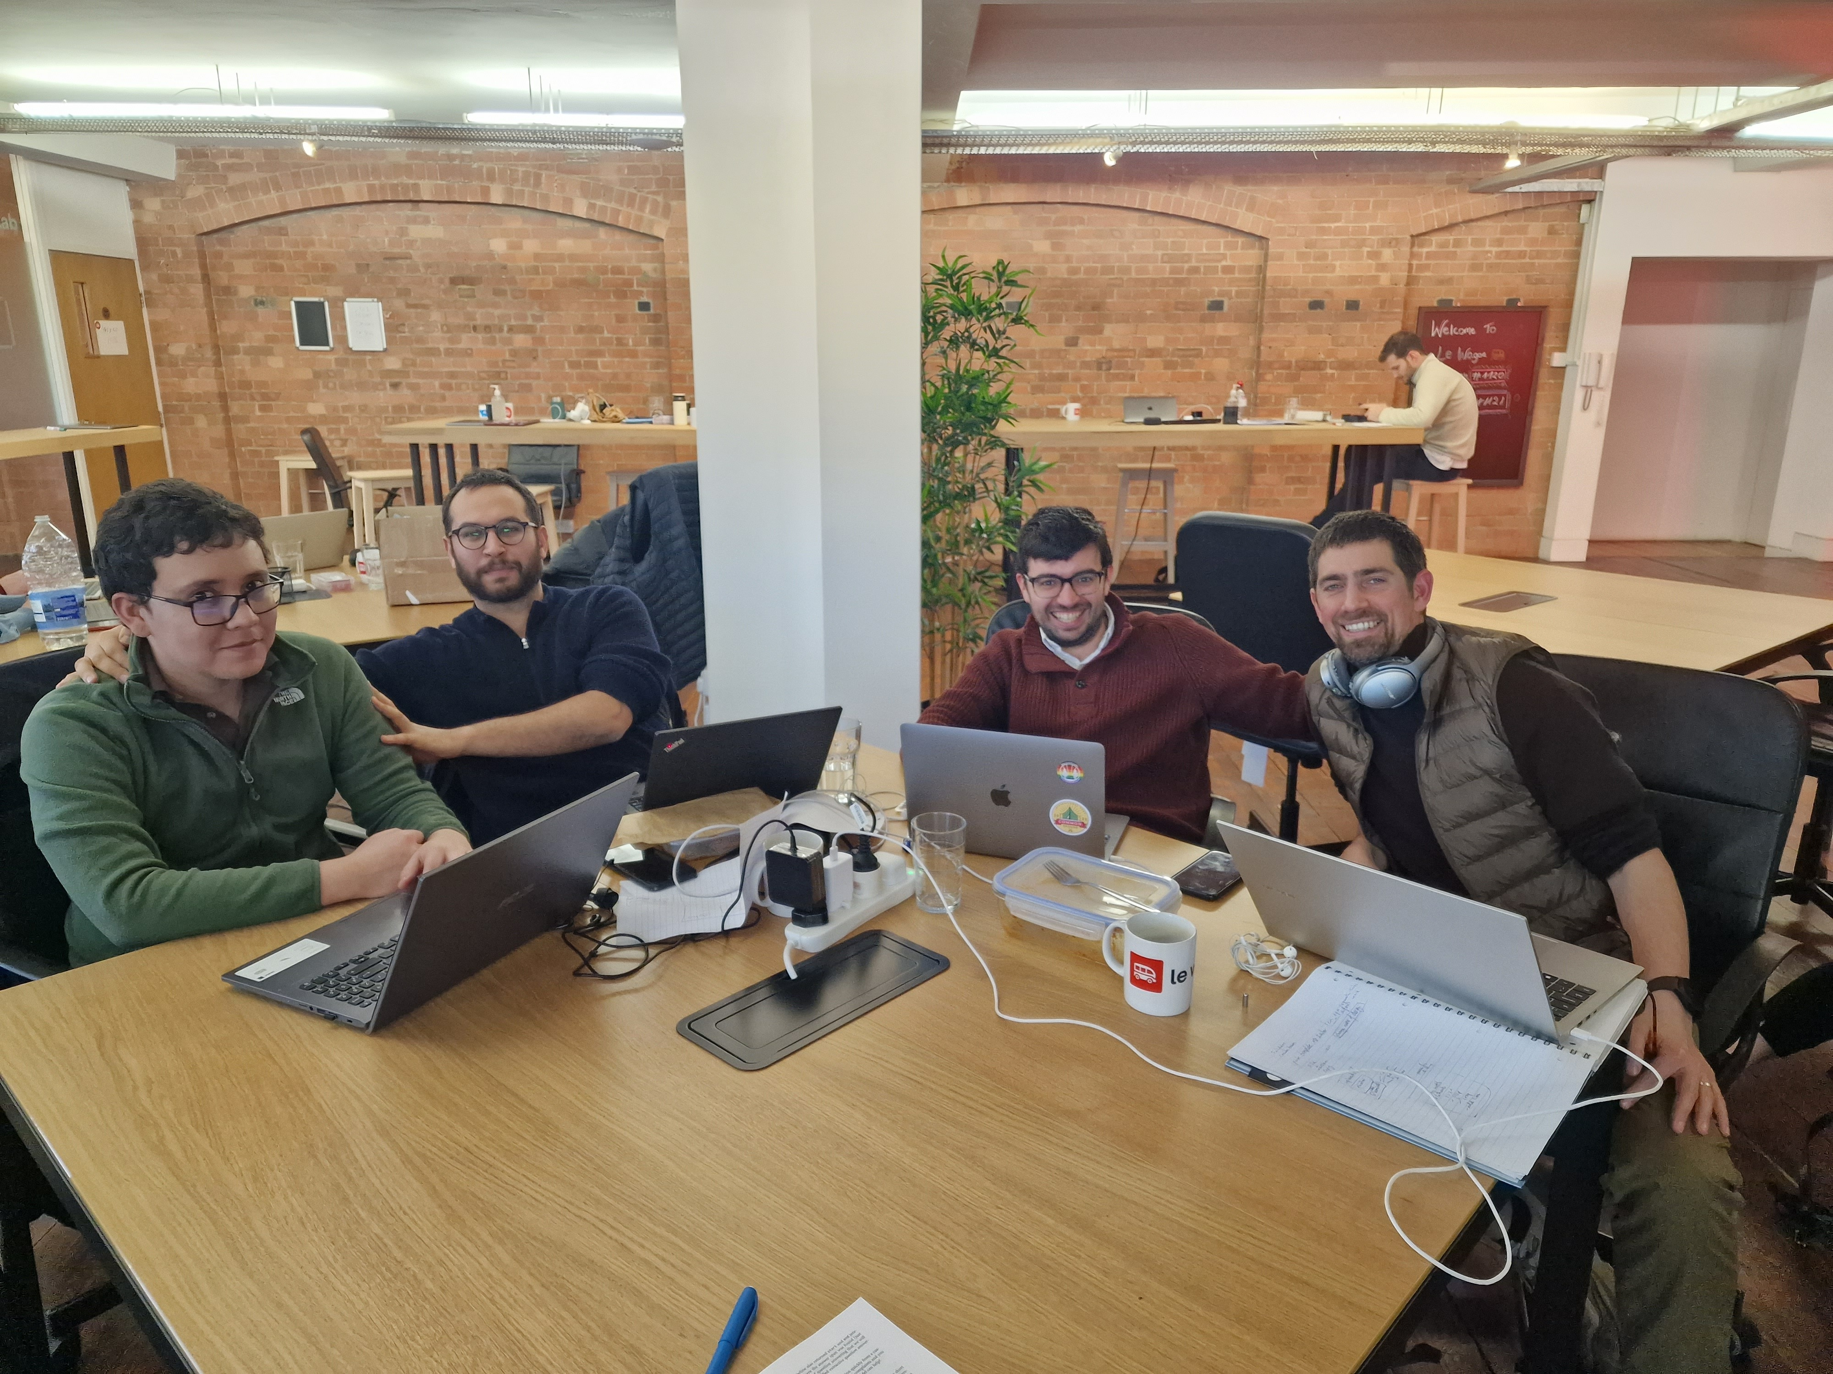

EndoGPT's team
Stumbled on BioGPT
Discovered transformers
Fought with Vertex, Anaconda and other beasts
Learned that models can hallucinate
Notes:
Summarise your research in three to five points.

Slide 3
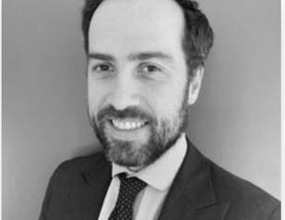
Prof Sebastian Zeki
Head of St Thomas hospital gastroenterology department
Determined to bring the data revolution to Medicine
… but need to circumvent by the Ethics Board
Opportunity to work on an unsolved problem
Notes:
Summarise your research in three to five points.

Slide 4
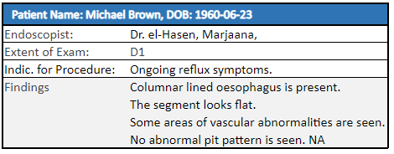
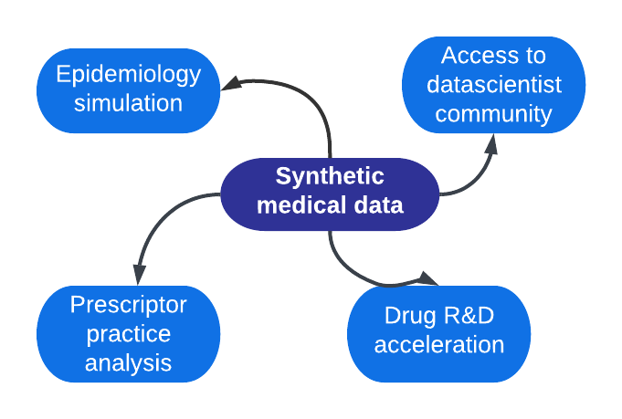
Synthetic Endoscopy reports
Medical grade synthetic data hard to achieve...
.. but opening massive opportunity for medical research
Ensure Medical coherence
Keep anonymous - GDPR
Erase patient 'fingerprint'
Medical grade rigor

Slide 5
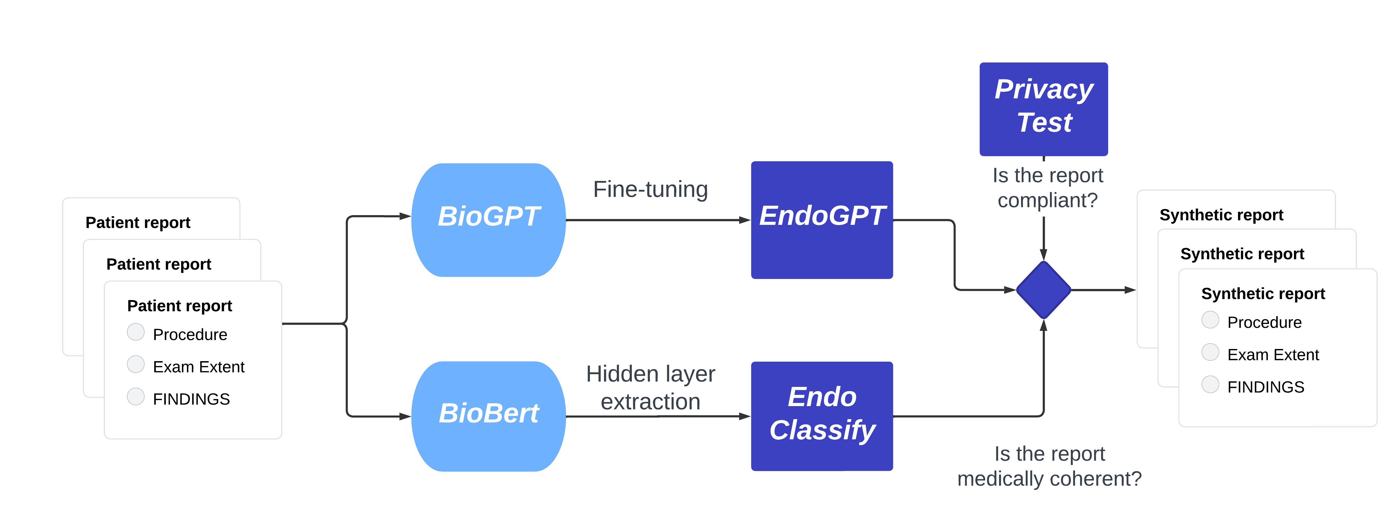
EndoGPT flow chart
Retrained on endoscopy semantic
Tokenized text distance
Transformers:
chatGPT technology
Tokenization

Slide 6
EndoGPT in action
EndoGPT model
EndoGPT Interface

Slide 7
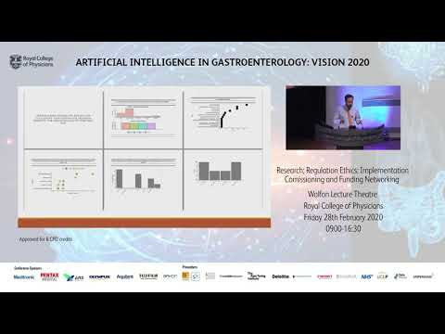
Seb's feedback

Slide 8


EndoGPT : Transformers
Transformers
ChatGPT
BioGPT
BioBert
EndoGPT
What is it about transformers that changed the field almost overnight?
Synthesis of various concepts including (self-) attention, transfer learning and neural networks scaling

